Slide 1
Chess Games Average Rating And Maximum Game Time
By Tim Inzitari

Slide 2
Dataset
“Chess Game Dataset (Lichess)” by Mitchell J on Kaggle.com
Over 20,000 games of chess played on website Lichess.org
16 datapoints
4 Used Datapoints: Start Time, End Time, Turn Count, White Player Rating

Slide 3
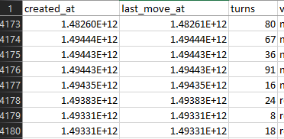
Zero-Time Issue
Many games are shown to taking 0 time based on significant digits stored in the Dataset

Slide 4
Problems Tackled
Average White Player Rating
Number of Non-Zero Time Games
Maximum length of a game

Slide 5
Distribution of Data
Split Data up based on minimum turn count for the game.
Turn count Lower Limits used were: 5, 10, 20, 40, and 80
Resulting in the following new Subsets
Lower Limit | 5 | 10 | 20 | 40 | 80
Dataset Size | 19716 | 19441 | 18397 | 14383 | 4900

Slide 6
Algorithms
First Algorithm
Calculates Number of Non-Zero time Games
Find the Maximum Game length in milliseconds
Second Algorithm
Find Average White Player Rating

Slide 7
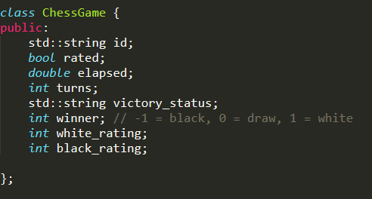
Implementation
C++
Pthreads
Mutex Critical Section Support

Slide 8
Non-Zero Games and Max Time
Lower Turn Limit | 5 | 10 | 20 | 40 | 80
Non-Zero Timed Games | 11271 | 11141 | 10579 | 8442 | 2998
Max Game Time | 6.058447e+8 | 6.058447e+8 | 6.058447e+8 | 9.0e+7 | 1.035103e+7

Slide 9
First Algorithm Speedup
SPEEDUP | 19716 | 19441 | 18397 | 14383 | 4900
1 | 1 | 1 | 1 | 1 | 1
2 | 1.364486 | 0.862779 | 1.048076 | 1.323864 | 1.124161
4 | 1.55872 | 0.888692 | 0.778571 | 0.958848 | 0.706751
8 | 0.881288 | 0.388117 | 0.536946 | 0.487448 | 0.332671

Slide 10
First Algorithm Efficiency
EFFICIENCY | 19716 | 19441 | 18397 | 14383 | 4900
1 | 1 | 1 | 1 | 1 | 1
2 | 0.682243 | 0.431389 | 0.524038 | 0.661932 | 0.56208
4 | 0.38968 | 0.222173 | 0.194643 | 0.239712 | 0.176688
8 | 0.110161 | 0.048515 | 0.067118 | 0.060931 | 0.041584

Slide 11
First Algorithm Conclusions
Not Scalable
Very weak at Critical Section of increasing global count or finding global max

Slide 12
Average White Player Ratings
Lower Turn Limit | 5 | 10 | 20 | 40 | 80
Average Rating | 1599.03 | 1600.82 | 1606.65 | 1616.19 | 1635.87

Slide 13
Second Algorithm Speedup
SPEEDUP | 19716 | 19441 | 18397 | 14383 | 4900
1 | 1 | 1 | 1 | 1 | 1
2 | 1.730129 | 1.561291 | 1.512658 | 1.534722 | 0.9346851
4 | 1.180328 | 1.310469 | 1.325323 | 1.361397 | 0.8755275
8 | 0.40502 | 0.74538 | 0.665121 | 0.581069 | 0.332

Slide 14
Second Algorithm Efficiency
EFFICIENCY | 19716 | 19441 | 18397 | 14383 | 4900
1 | 1 | 1 | 1 | 1 | 1
2 | 0.865064 | 0.780645 | 0.756329 | 0.767361 | 0.4673426
4 | 0.295082 | 0.327617 | 0.331331 | 0.340349 | 0.2188819
8 | 0.050627 | 0.093172 | 0.08314 | 0.072634 | 0.0415

Slide 15
Second Algorithm Conclusions
Not Scalable, also weak at critical sections
Potential link between Turn Count and Average Rating

Slide 16
Further Research
Machine Learning to find a regression algorithm on Rating vs Turn Count
Larger Dataset of games to further confirm scalability
Other Parallel APIs and Critical Section structures

Slide 17
References
J, M. (2017). Chess Game Dataset (LiChess). Retrieved from Kaggle: https://www.kaggle.com/datasnaek/chess

